Slide 1
Chapter 8
Principal Components

Slide 2
8.1 INTRODUCTION
A principal component analysis is concerned with explaining the variance-covariance structure of a set of variables through a few linear combinations of these variables. Its general objective are (1) data reduction and (2) interpretation.

Slide 3

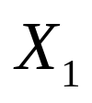
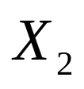
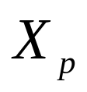


8.2 POPULATION PRINCIPAL COMPONENTS
Algebraically, principal components are particu-lar linear combinations of the random variab-les , , , . Geometrically, these linear combinations represent the selection of a new coordinate system obtained by rotating the origi-nal system with , , , as the coordina-te axes. The new axes represent the directions with maximum variability.
As we shall see, principal components dep-end solely on the covariance matrix (or the

Slide 4

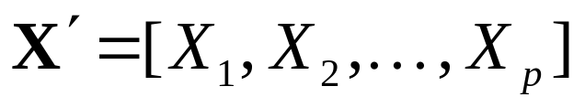

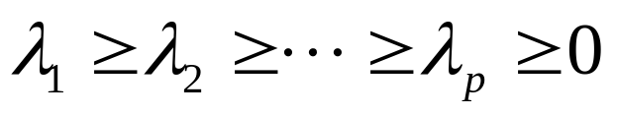
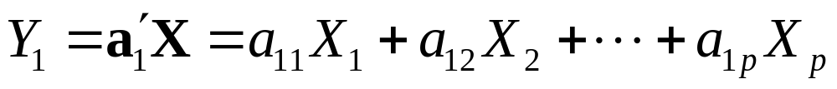

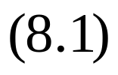

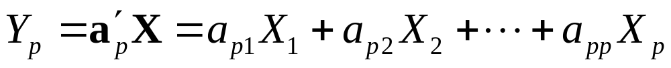
correlation matrix ) of , , , .
Let the random vector have the convariance matrix with eigenvalues
.
Consider the linear combinations

Slide 5
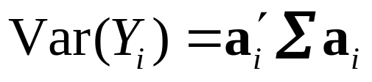
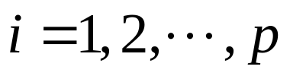
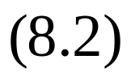
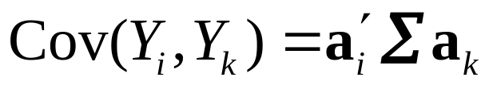
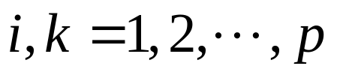
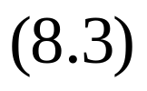



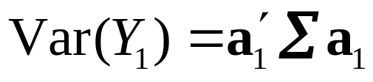
Then, we obtain
The principal components are those uncorrelated linear combinations , , , whose variances in (8.2) are as large as possible.
The first principal component is the linear combination with maximum variance. That is, it maximizes . It is clear that

Slide 6

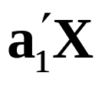
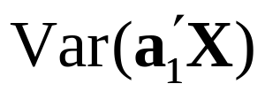
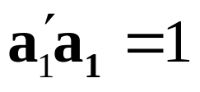
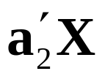
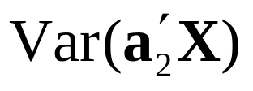
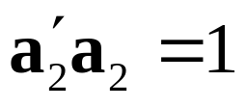
can be increased by multiplying any by some constant. To eliminate this indete-rminacy, it is convenient to restrict attention to coefficient vectors of unit length. We therefore define
First principal component=linear combination
that maximizes subject to
Second principal component=linear combination
that maximizes subject to

Slide 7
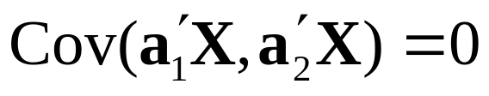

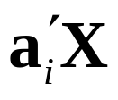
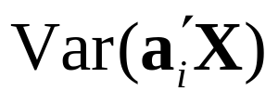

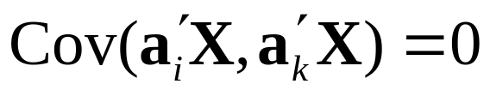


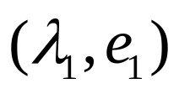
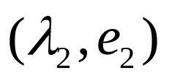
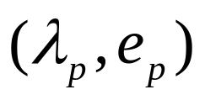

and
At the ith step,
th principal component=linear combination
that maximizes subject to
and for
Result 8.1. Let be the convariance matrix associated with the random vector . Let have the eigenvalue-eigenvector pairs , , ,
Where . Then the th principal comp-
onent is given by

Slide 8
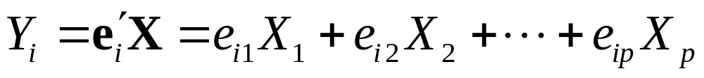
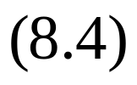
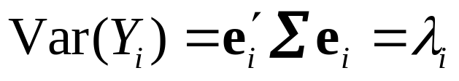
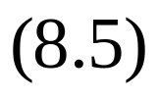
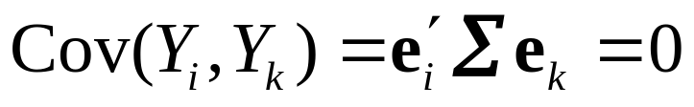




With these choices,
If some are equal, the choices of the correspon-ding coefficient vectors, , and hence , are not unique.

Slide 9


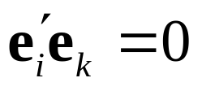



perpendicular to (that is, , ) gives
. Now, the eigenvectors of are orthogonal if all the eigenvalues , , , are distinct. If the eigenvalues are not all distinct, the eigenvectors corresponding to common eigenval-ues may be chosen to be orthogonal. Therefore, for any two eigenvectors and , , .

Slide 10
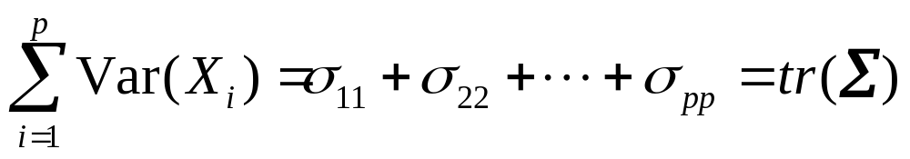
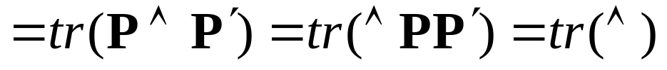
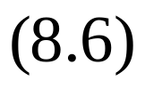
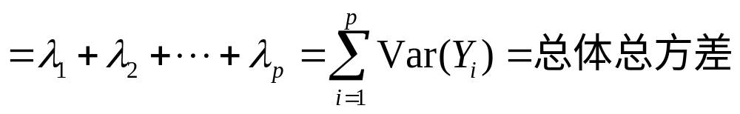
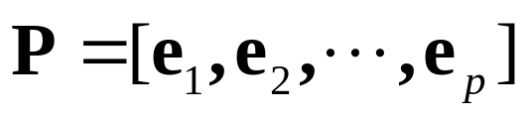

Result 8.2.
Where and

Slide 11


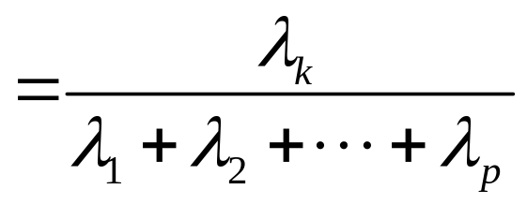
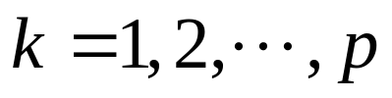
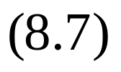
This is the proportion of total variance explained by the
kth principal component.
Proportion of total
population variance
due to kth principal
component

Slide 12
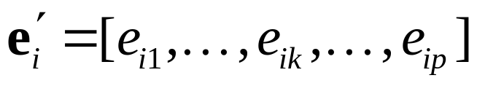

If most (for instance, 80 to 90%) of the total popu-lation variance, for large , can be attributed to the
the first one, two, or three components, then these components can “replace” the original variables without much loss of information.
Each component of the coefficient vector
also merits inspection. The
magnitude of measures the importance of the kth variable to the ith principal component,

Slide 13
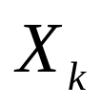
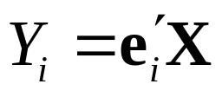
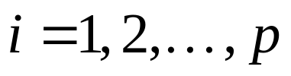
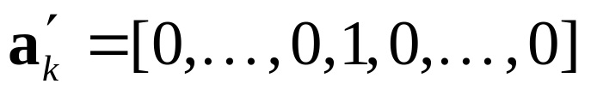
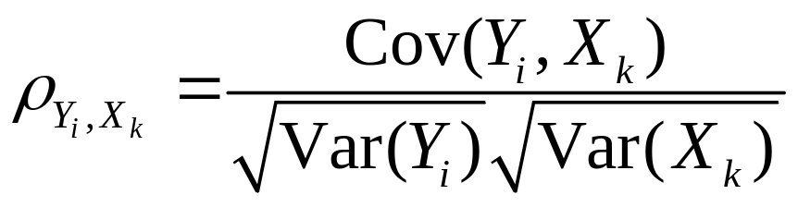
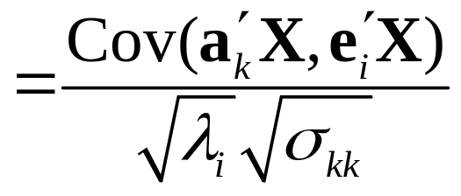
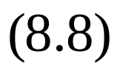


irrespective of the other variables. In particular, is proportional to the correlation coefficient betw-een and , because of ( ).
Result8.3. Set , it may yield

Slide 14












Example 8.1 (Calculating the population principal components) p.350
, , ,
, , ,
, , ,

Slide 15






Ex. Euclid space ,
, ,
Step 1,
.

Slide 16



Step 2,

Slide 17




Step 3,

Slide 18



Slide 19




Principal Components Obtained from Standardized Vari-ables

Slide 20








In matrix notation,
where the diagonal standard deviation matrix is defined in (2-35). Clearly, and
Result 8.4.

Slide 21








The total (standardized variables) population variance is simply , the sum of the diagonal elements of the matrix . Using (8.7) with in place of , we find that the proportion of total variance explained by the kth principal component of is
Proportion of total
population variance
due to kth principal
component

Slide 22

where the ’s are the eigenvalues of .
Example 8.2 (Principal components obtained from covariance and correlation matrices are different)
P.433

Slide 23
Standardization is not inconsequential.Variables should probably be standardized if they are meas-ured on scales with widely differing ranges or if the units of measurement are not commensurate.

Slide 24
8.3 SUMMARIZING SAMPLE VARIATION BY PRINCIPLE COMPONENTS
Example 8.3 (Summarizing sample variability wi-th two sample principle components)
P.439

